Slide 1
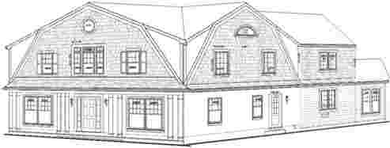
Project:
10237 Parkwood Drive
Kensington, MD 20895

Slide 2
Agenda
Introduction to RenovationStudio
Overview of the Parkwood Project
Architectural Plans
Budget Breakdown
Maps
Comps Sold
Comps/Open Houses

Slide 3
Who is RenovationStudio
We are a design-build firm specializing in residential construction.
Our services include: investment property transformations, complete house renovations, single and multi-level additions, porches, garages, basements and kitchen renovation.
We also offer Design and Architectural services.
Located in Kensington, Maryland - just outside of Washington, DC - the firm was founded on hard work, a passion for building, honesty and determination.

Slide 4
10237 Parkwood Drive Project
Purchase Price: $510,000 (20% down)
Anticipated Sale Price: $1,250,000
Lot size: 12,581 SF
BR/FB/HB (after renovation): 5/3/1
Looking for a private investor to lend $460,000 to complete renovation
Return on investment within 6 months
Terms to be negotiated

Slide 5
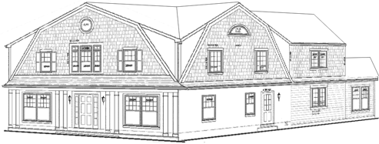
Parkwood 3-D

Slide 6
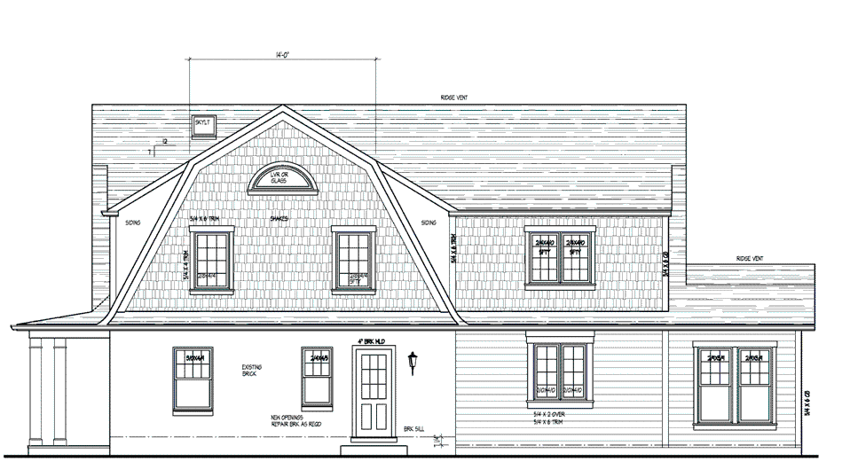
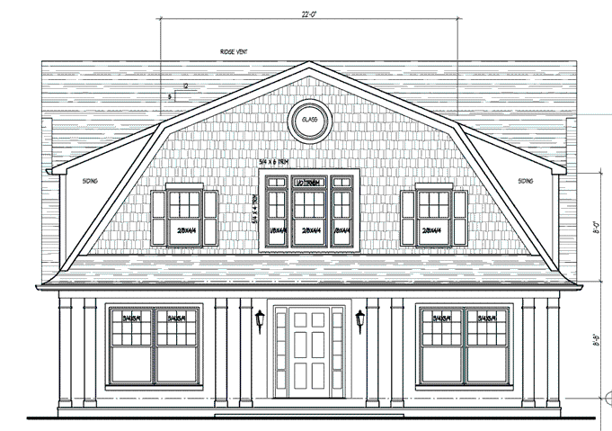
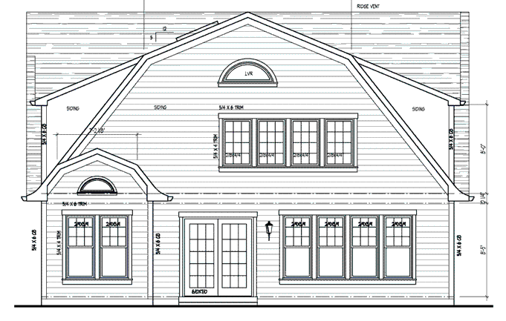
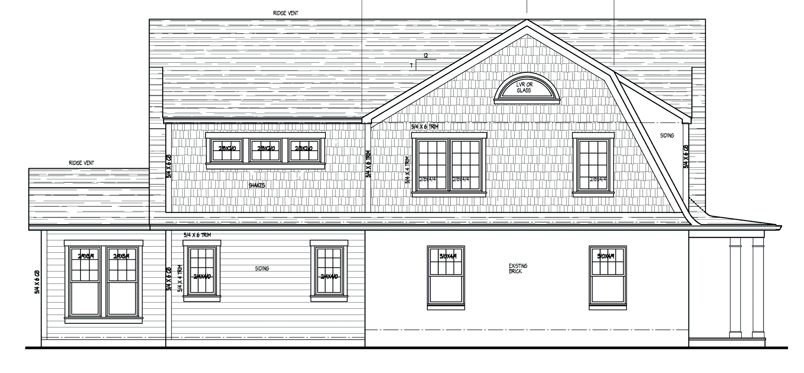
Parkwood Elevations
Front
Right
Back
Left

Slide 7
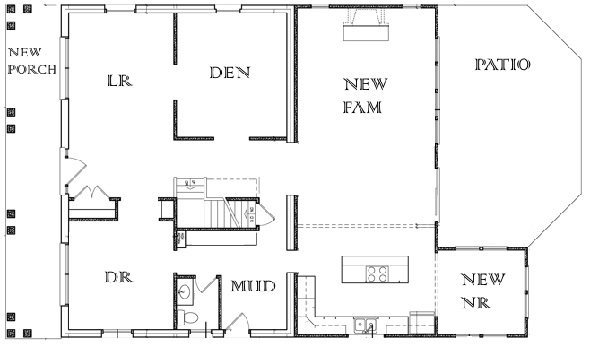
First Floor

Slide 8
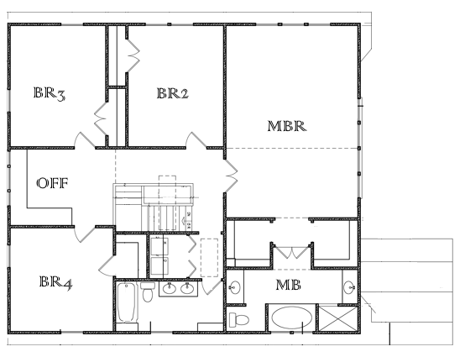
Second Floor

Slide 9
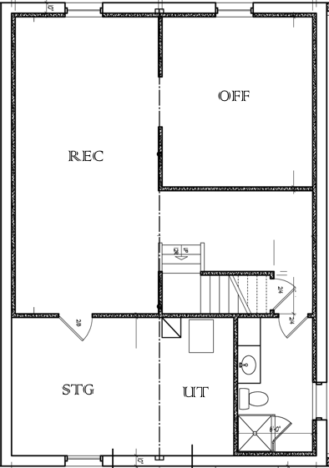
Basement

Slide 10
Parkwood Budget Breakdown
Description | Amount
Architecture plans, permit, Demolition | $60,000
Foundation, lumber order | $70,000
Framing; windows, roofing, siding | $80,000
HVAC, Electrical, Plumbing | $60,000
Drywall, insulation, finishing | $80,000
Painting, Flagstone, landscaping, finishing | $70,000
Monthly carry costs: including PITI/mortgage ($2100), utilities ($250) & builders fee ($4315) – all for 6 month timeline | $40,000
TOTAL | $460,000

Slide 11
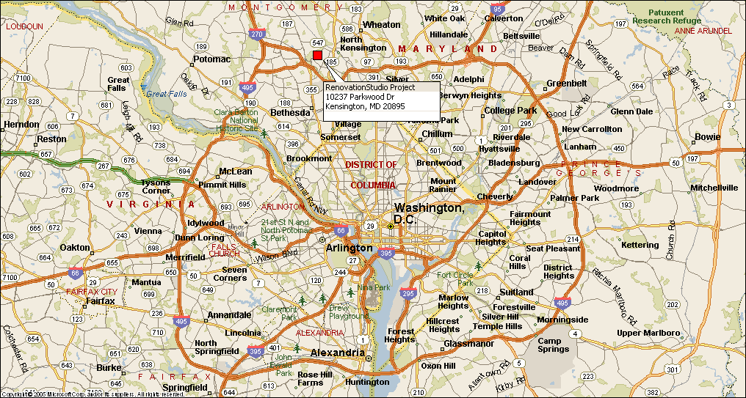
DC Metro Area and Parkwood Property
Kensington is approximately 4 miles north of the DC line, which makes the town a very appealing, close-in location for buyers. The property is also part of one of the finest school districts in the county and the country.

Slide 12
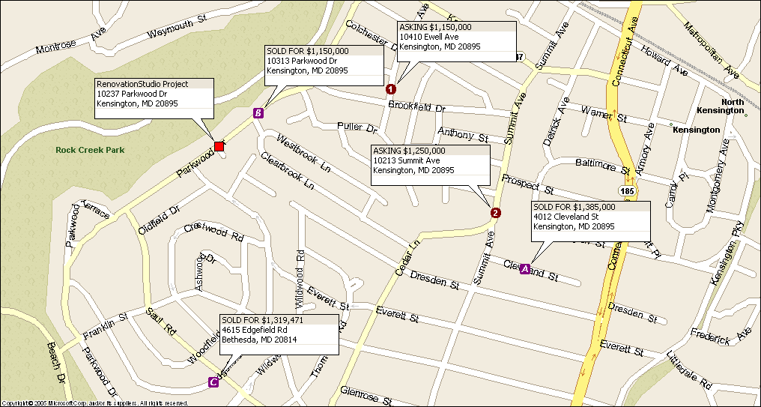
Recently Sold Houses and Current Listings

Slide 13
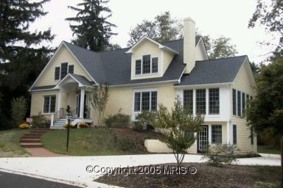
Comps Sold
A. Cleveland St - SOLD FOR $1,385,000
Contract Date: | 02-Nov-2005
BR/FB/HB: | 6/4/1
Lot Square Feet: | 12,197
Address: | 4012 Cleveland St Kensington, MD 20895
Contract Price: | $1,385,000

Slide 14
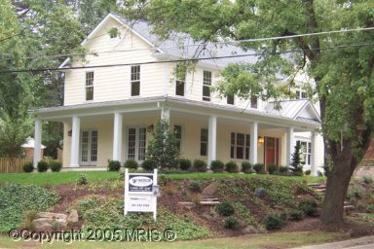
Comps Sold Cont…
B. Parkwood Dr - SOLD FOR $1,150,000
Contract Date: | 23-Oct-2005
BR/FB/HB: | 5/3/1
Lot Square Feet: | 7,332
Address: | 10313 Parkwood Dr Kensington, MD 20895
Contract Price: | $1,150,000

Slide 15
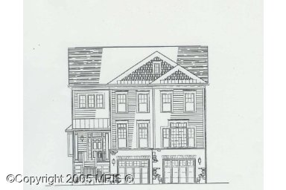
Comps Sold Cont…
C. Edgefield Rd - SOLD FOR $1,319,471
Contract Date: | 23-Sep-2005
BR/FB/HB: | 6/5/1
Lot Square Feet: | 6,970
Address: | 4615 Edgefield Rd Bethesda, MD 20814
Contract Price: | $1,319,471

Slide 16
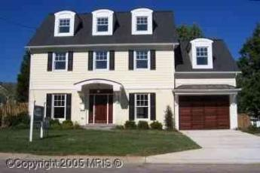
Comps Open Houses
1. Cleveland St - Asking $1,150,000
BR/FB/HB: | 5/3/2
Lot Square Feet: | 6,098
Address: | 10410 Ewell Ave Kensington, MD 20895
Asking: | $1,150,000

Slide 17
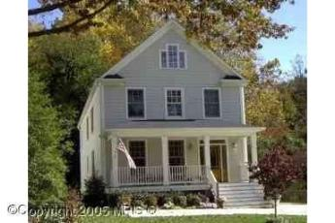
Comps Open Houses Cont…
Summit Ave - Asking $1,250,000
BR/FB/HB: | 6/4/1
Lot Square Feet: | 7,841
Address: | 10213 Summit Ave Kensington, MD 20895
Asking: | $1,250,000

Slide 18

Questions? Please Contact Us!

